Slide 1
A Presentation on:
“Rock Paper Scissors Game”
Submitted by:
Samir Shrestha (21070664)
Bhawana Ojha (21070631)
Submitted to:
Department of Computer and science engineering

Slide 2
OUTLINE
OBJECTIVES
MOTIVATION
SCOPE AND APPLICATION
METHODOLOGY
Flowcharts
RESULTS AND ANALYSIS
PROJECT REQUIREMENT
REMAINING TASK
CONCLUSION
REFERENCES

Slide 3
OBJECTIVE
To develop the players decision-making skills.

Slide 4
MOTIVATION
It is a fun project to learn new programming language or practice coding skills.
It provide a engaging experience for players.

Slide 5
SCOPE AND APPLICATION
It can be used as casual game for people who seek a quick and simple diversion from their daily routine.
It can be used as an education tool.

Slide 6
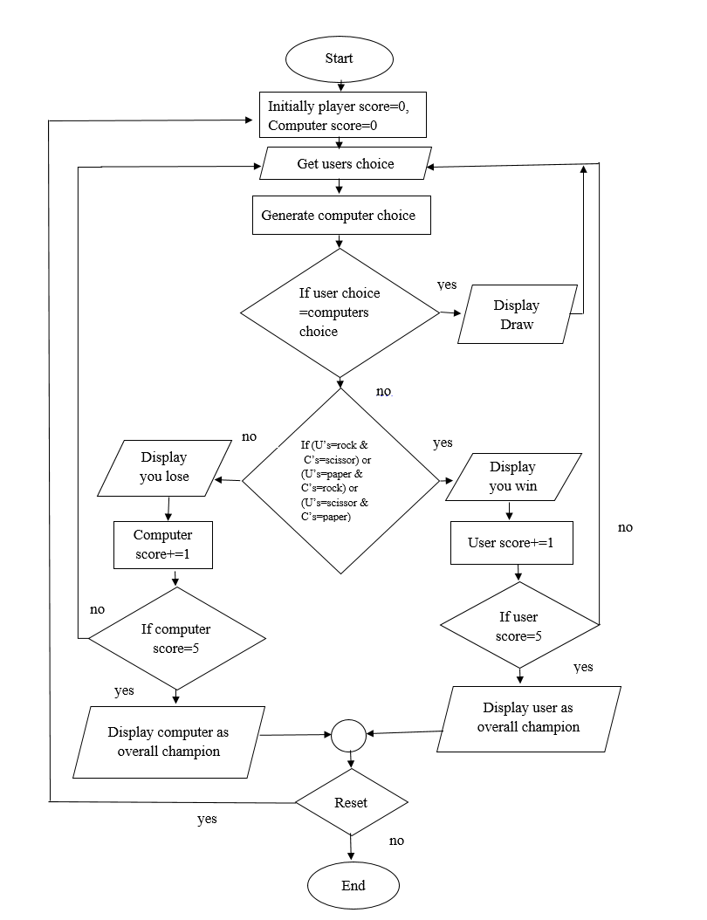
METHODOLOGY
Flowchart

Slide 7
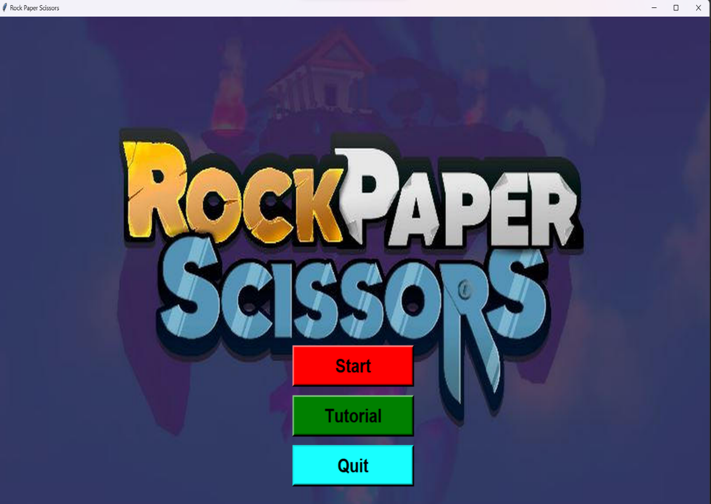
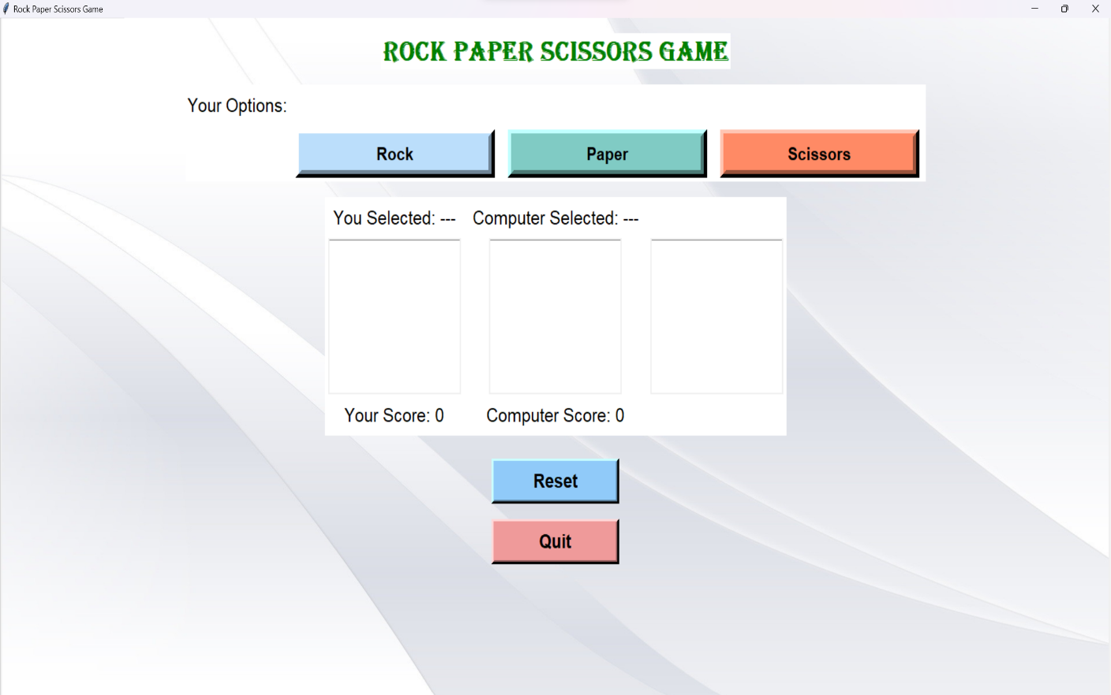
RESULTS AND ANALYSIS
GUI of the starting window
GUI of the main game window

Slide 8
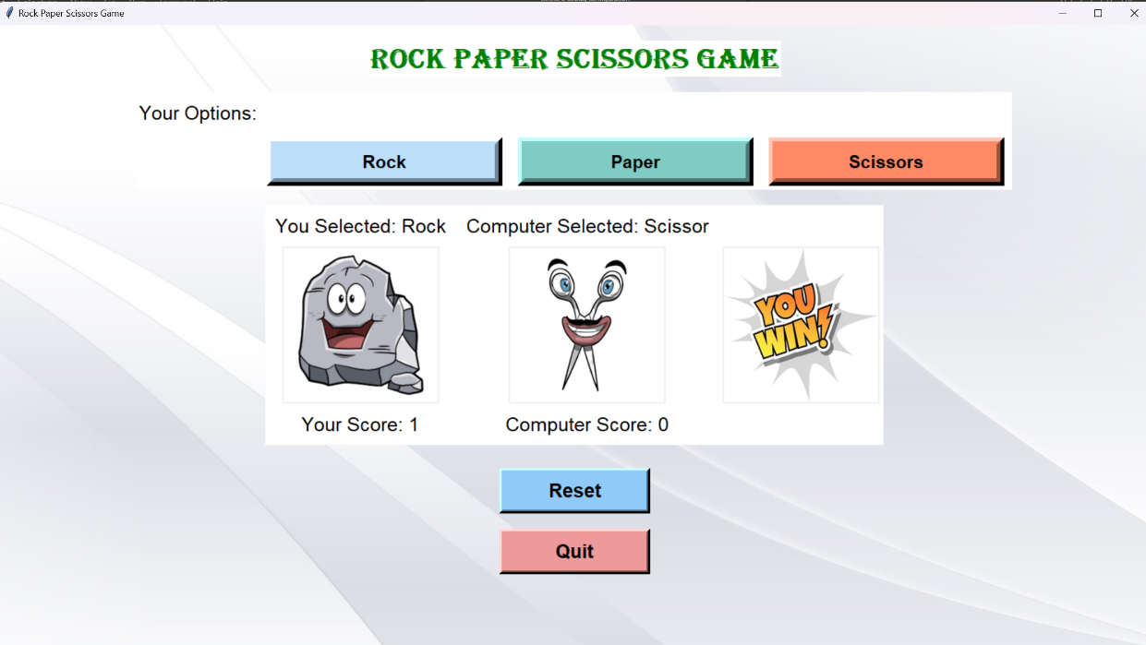
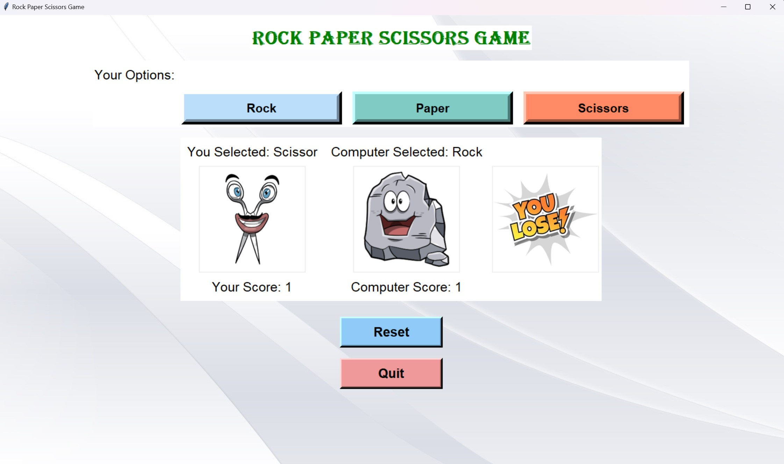
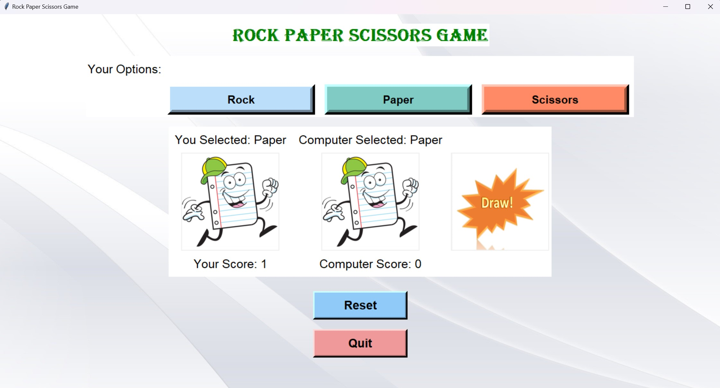
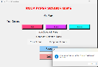
RESULTS AND ANALYSIS
Displaying user win
Displaying user loss
Displaying game draw

Slide 9

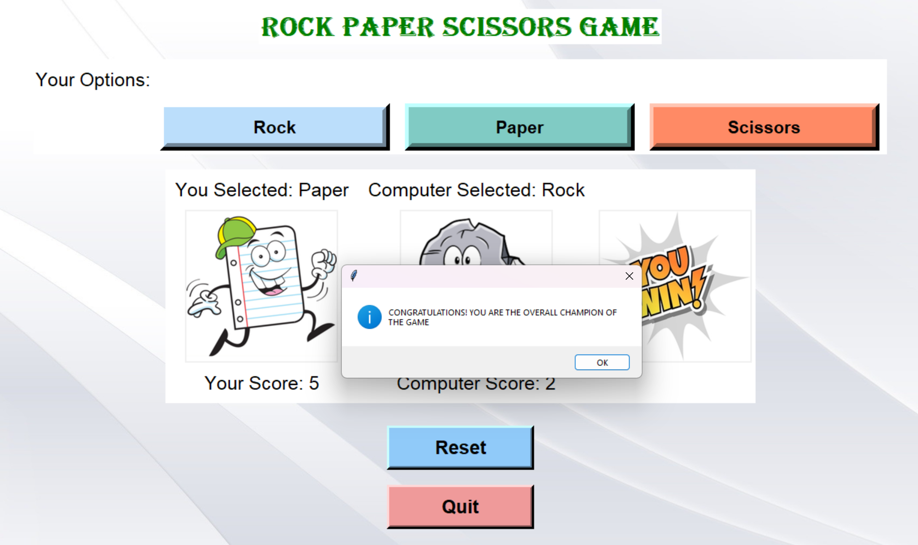
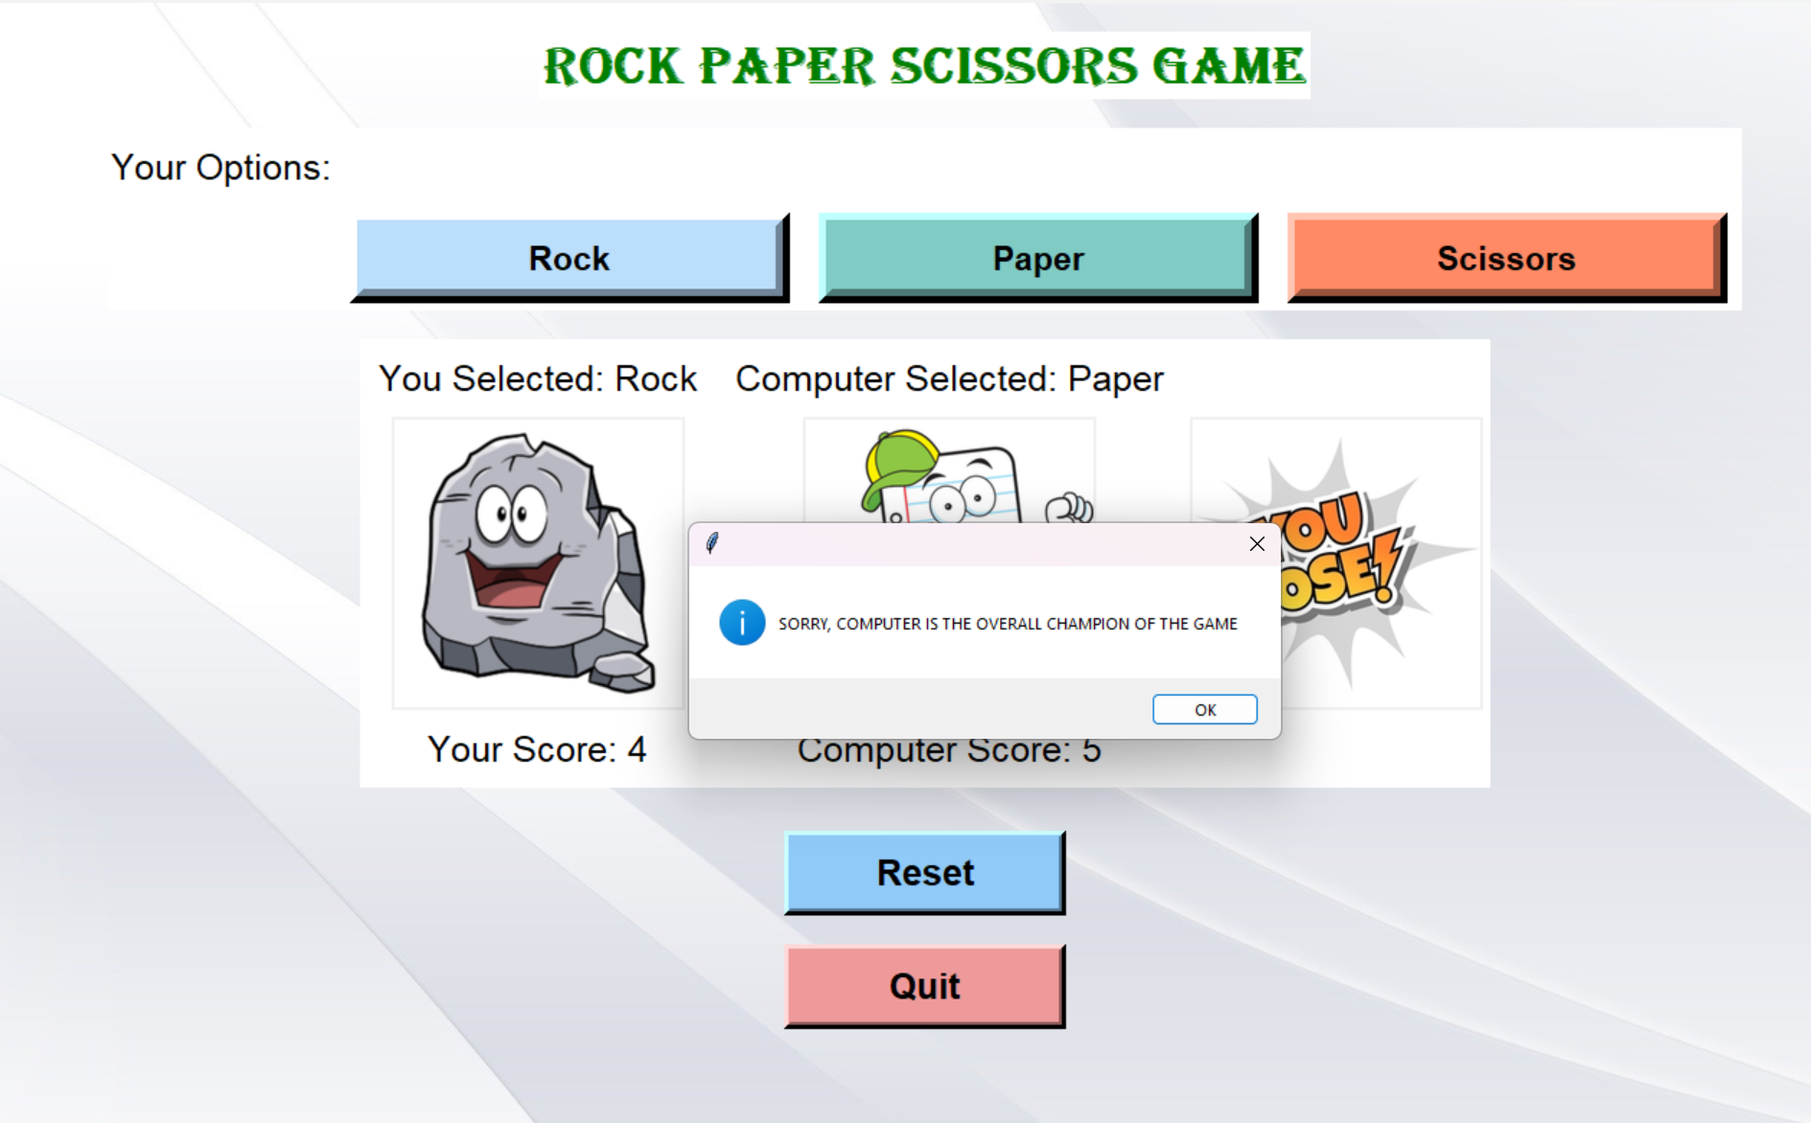
RESULTS AND ANALYSIS
Displaying player as overall champion of the game
Displaying computer as overall champion of the game

Slide 10
FUTURE ENHANCEMENT
Implementing a multiplayer mode where two human players can play against each other.
Enhancing the visual appeal of the game by improving the graphics, adding animations.
Adding the additional features like time mode and difficulty level.

Slide 11
Conclusion
Overall, Our “Rock Paper Scissors game” is digital version of classic hand game played with computer that is a simple yet engaging game made using Python language and its various modules and libraries. Our project demonstrates the understanding of GUI programming, event handling, sound integration and image processing making it a valuable learning experience in game development with Python.
12

Slide 12
References
[1] G. C. Zhang Hanshu, Moisan Frederic, “Rock-paper-scissors play: Beyond the win-stay/lose-change strategy,” Games 12, vol. 52, p. 3, 2021. [2] B. McCanon, “Rock paper scissors,” Journal of Economics, pp. 67–88, 2007. [3] C. Dunn, “Rock paper scissor project,” 2015. [4] A. Kharwal, “Rock paper scissors game using python,” 2022.

Slide 13
Thank
You!!

